Slide 1


Proposal –
Bangladesh Police
Cyber Awareness Campaign
A complete proposal for creating cyber Awareness in maharashtra State during
the rise of Cyber Threats, Cyber Scams, Online Fraud and Call Spamers.

Slide 2

Cyber Awareness
Campaign
Welcome to our presentation!
OUR AIM IS TO CREATE AWARENESS AMONG
POLICE OFFICERS, THE PUBLIC, ESPECIALLY
WOMEN AND GIRLS, ON THE SHARP RISE IN
THE CYBERCRIMES IN THE STATE.
2022
New Technology
A wonderful serenity has taken possession of my entire soul, like these.

Slide 3

Moto of
Cyber Awarness
Campaign
TO ENSURE A CYBER SAFE AND SECURE WORLD,BANGLADESH POLICE AND WE HAVE TO TAKE THIS INITIATIVE FURTHER
The month-long awareness campaign would include online sessions in the form of webinars, workshops, competition, covering different topics related to cybercrimes. Experts from across the country will also take part in this campaign and conduct webinars to teach women and girls how to protect themselves in the cyberspace.

Slide 4
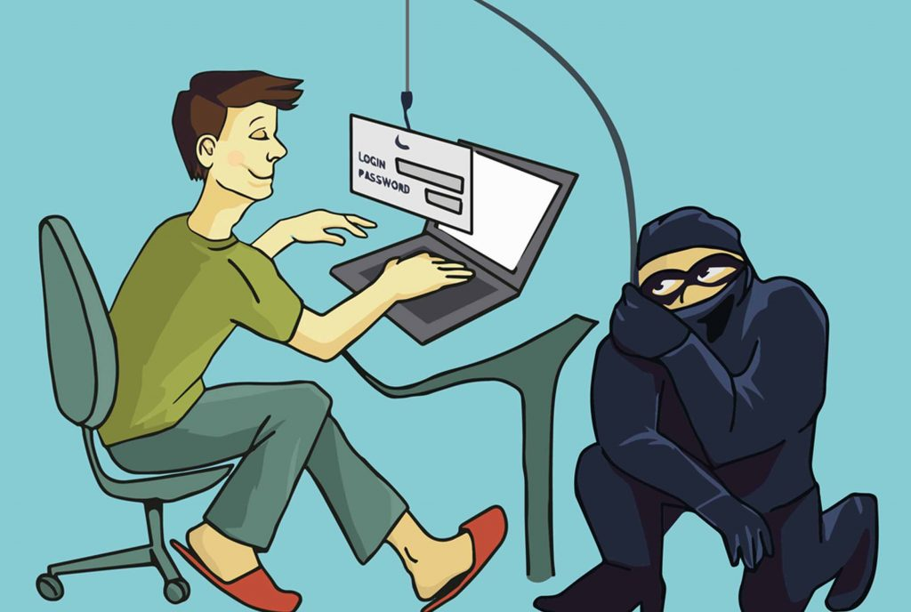
”
ALWAYS REMEMBER!
CYBER SECURITY IS MORE THAN A MATTER OF IT / DEFENCE TECH.
AWARENESS CAMPAIGN, RISE TO SPEAK,
METHODS TO DETECT AND PROTECT FROM
RISING CYBER CRIME IS MORE INPORTANT
TO SUSTAIN AND MAKE IT A HABIT.

Slide 5

5
01
Duration
3 Months
02
Audience that will be covered
Conductive
Points-
Police forces
women and children
senior citizen
Retired police officers
03
Activities that will be conducted
Sessions on cyber awareness
cyber dialogue painting competition
quiz compition
hackathon
virtual conference with leaders in tech
04
Research & Report
Apart from this, we will also provide a Research
report on current threat in cyber space in that state.
© Global Management Solution.

Slide 6
Strategy and Implementation
HOW WILL WE DELIVER THE AWARENESS CAMPAIGN!
1
2
3
City Based Session and
collaborating with various
schools and education
institution.
Awareness Campaign for
different sections and cells of
Police Departments in the state.
Using state-or-art tools and
resources to showcase the
current cyber technology
and teaching out citizens on
Cyber Hygiene Practices.

Slide 7

7
PUTTING IT ALL TOGETHER
Children and Women
With internet gaining popularity, an exponential rise in crimes against
women and children have been witnessed. A survey by Microsoft evealed that India ranks third in the number of cyberbullying cases amongst children. The tragic part is children dread their parents and do not inform them about being bullied. They continue to suffer alone ilently. Women, on the other hand, are victims of crimes like stalking, identity theft, revenge porn etc. Sensitisation of women and children is, therefore, the need of the hour. We under various initiatives like iSafe Alliance, Digital Shakti, e-Raksha, Cyber Clinic, Internet De-Addiction, CyberSecurity Helpline, etc. constantly strives to reach out to women and children in order to create awareness about online safety.
Our initiatives are targeted at building capacity and empowering citizens not just on online safety but resilience and responsible online behaviour as well. We actively deal with cases and help victims on different fronts like law enforcement support, counselling, techno-legal
help etc.
© Global Management Solution.

Slide 8
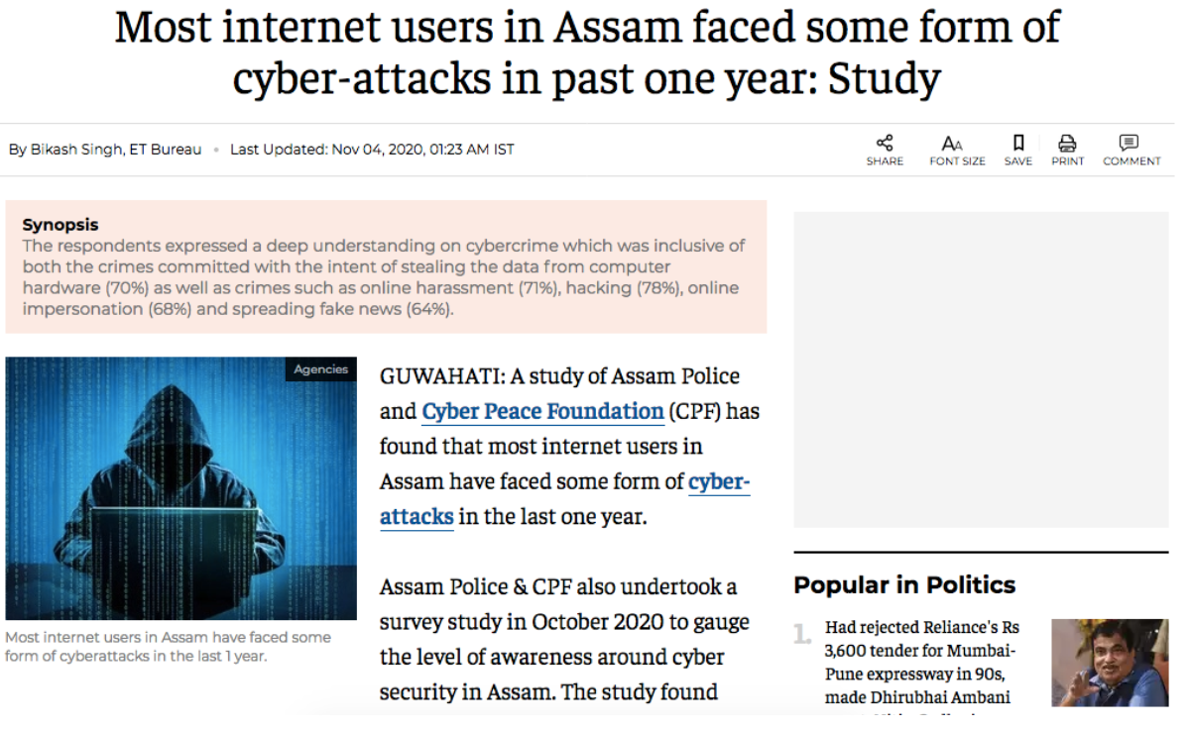
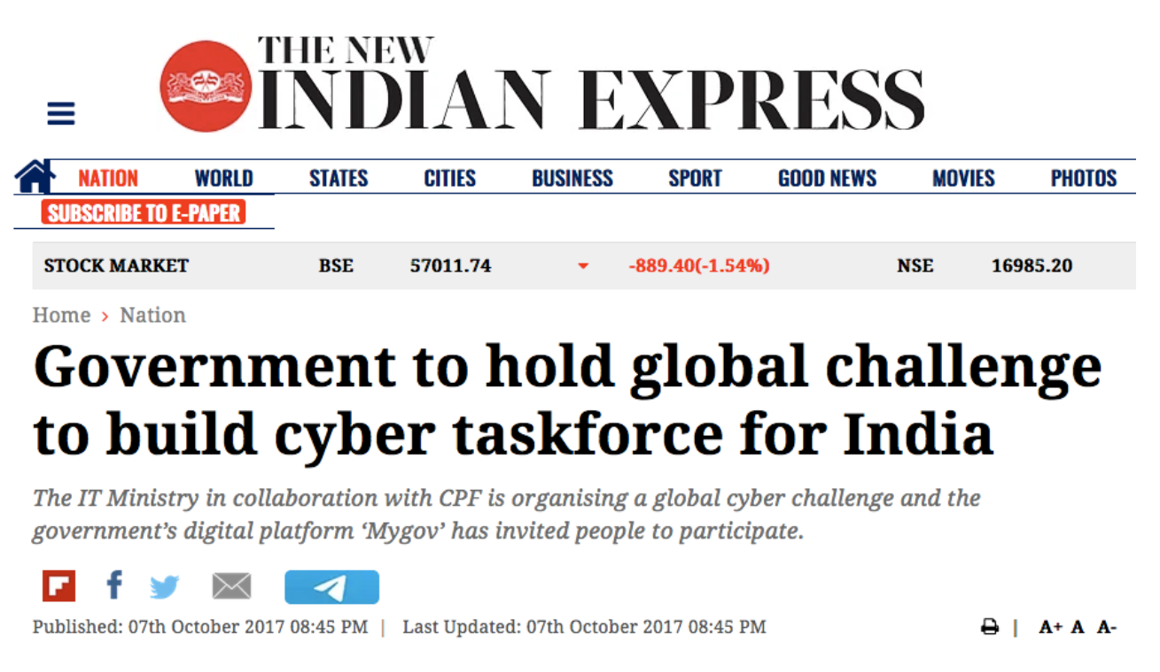
8
© Global Management Solution.

Slide 9
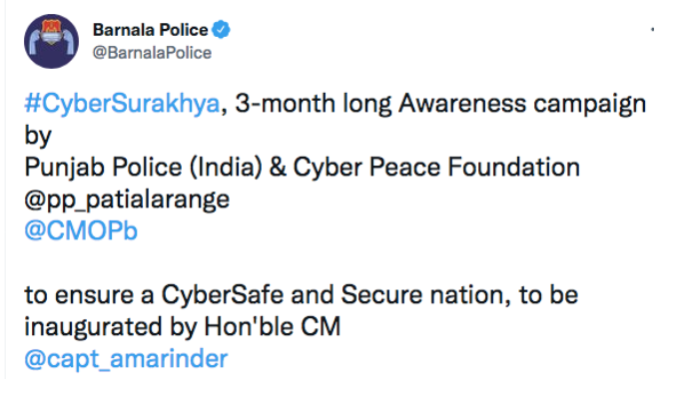
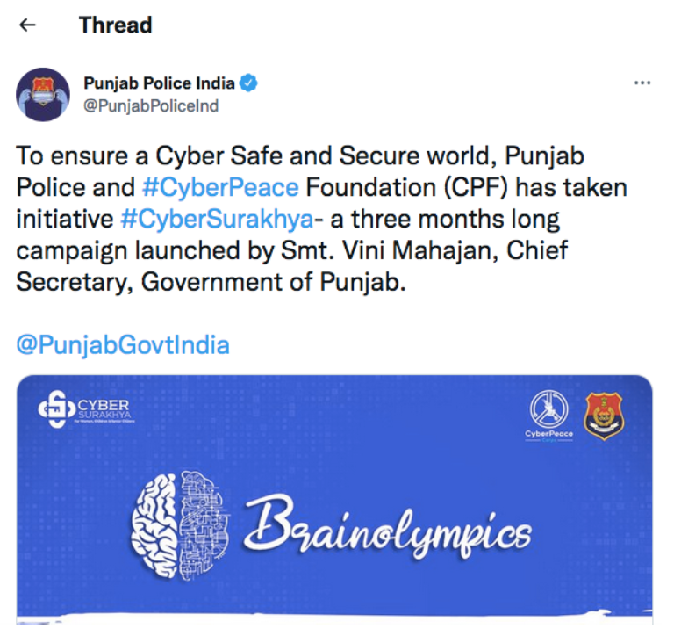
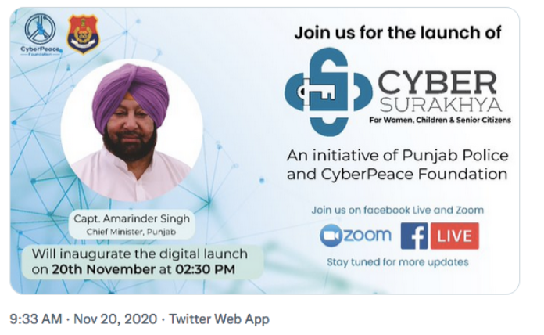
9
© Global Management Solution.

Slide 10
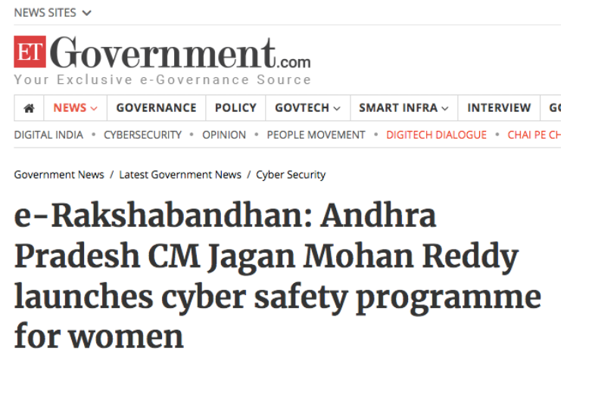
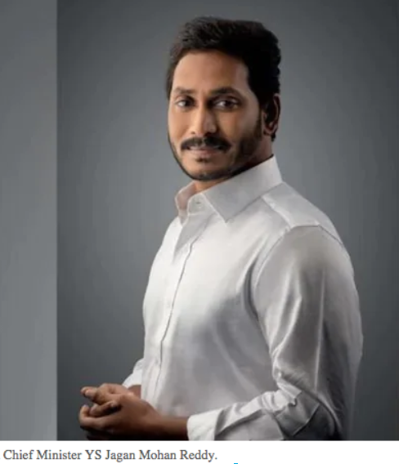
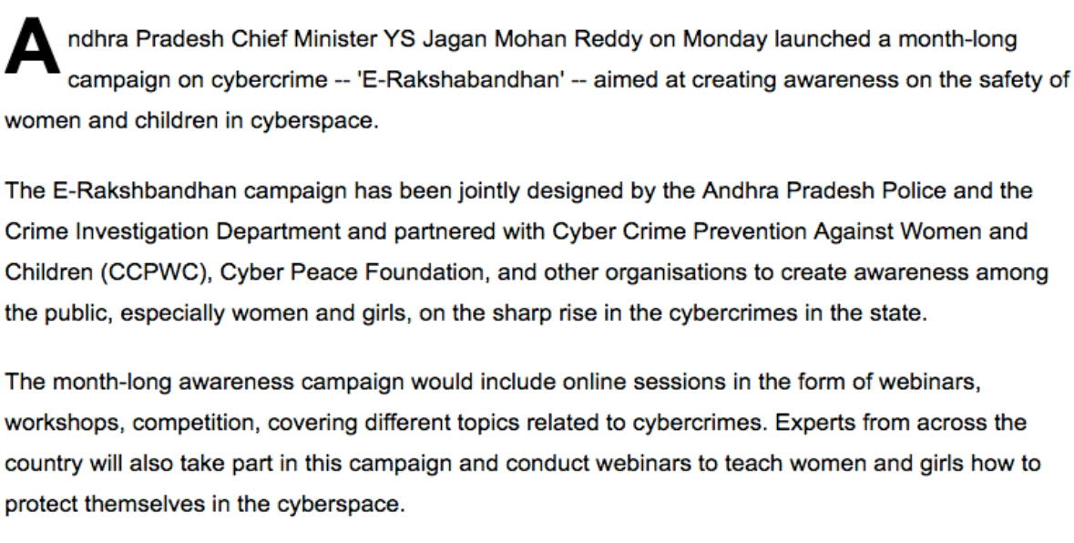
10
Copyright © AeroTech. All rights.

Slide 11
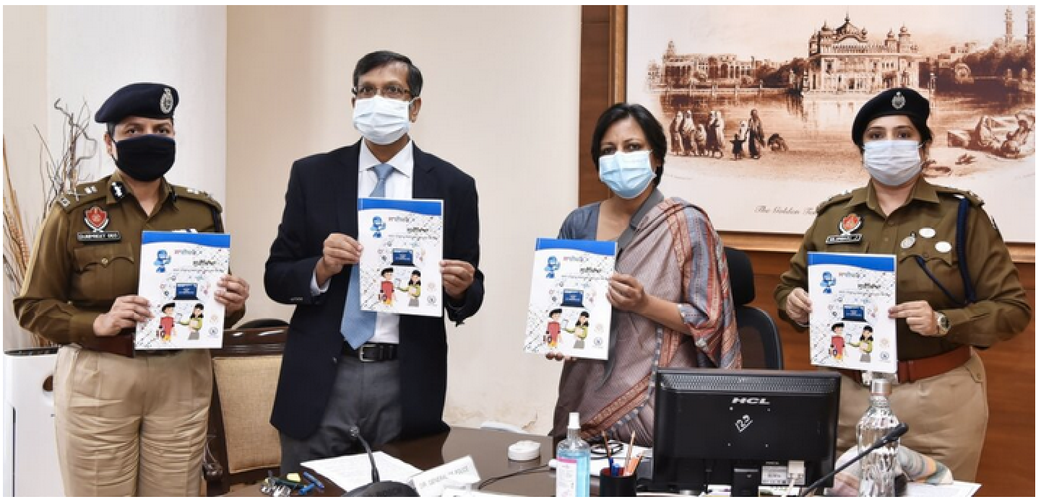
11
Chief Secretary Lanches
Punjab Police
CYBER SURAKHYA campaign to curb online frauds.
© Global Management Solution.

Slide 12
Copyright © AeroTech. All rights.

Slide 13
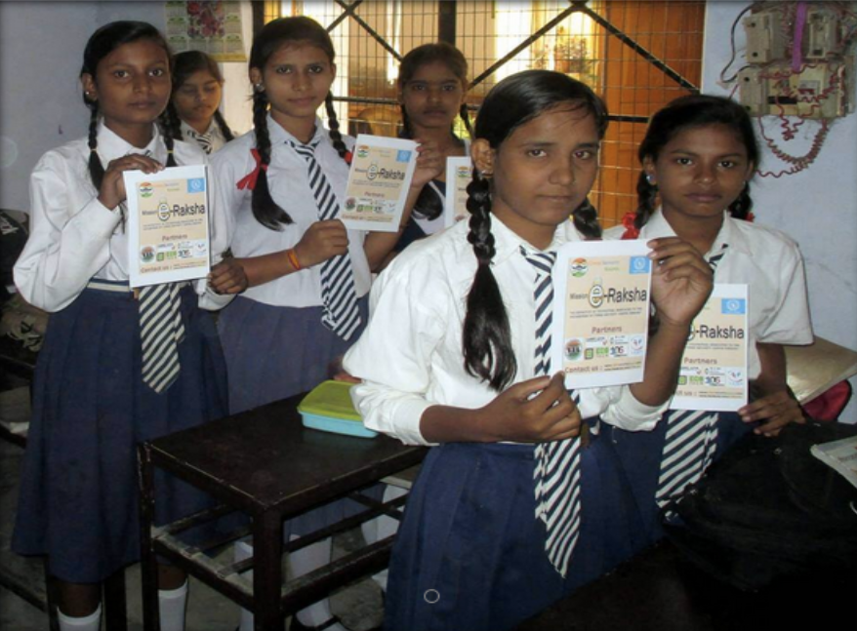
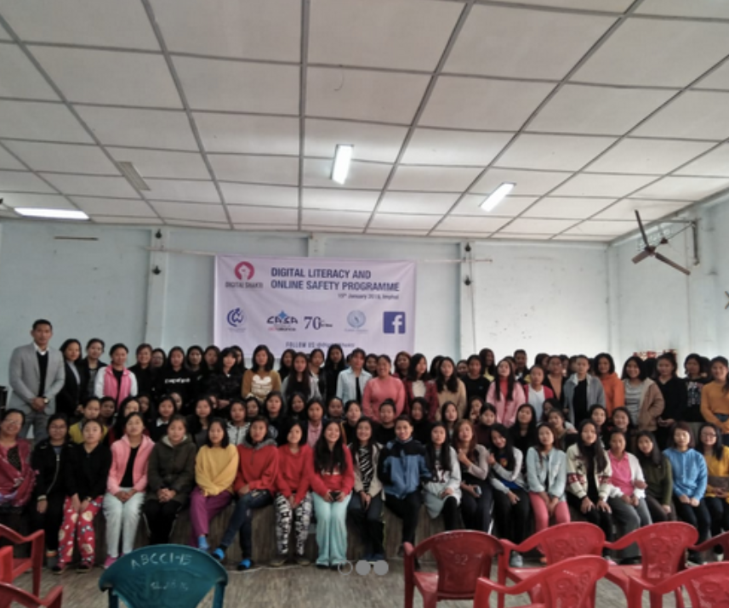

Slide 14
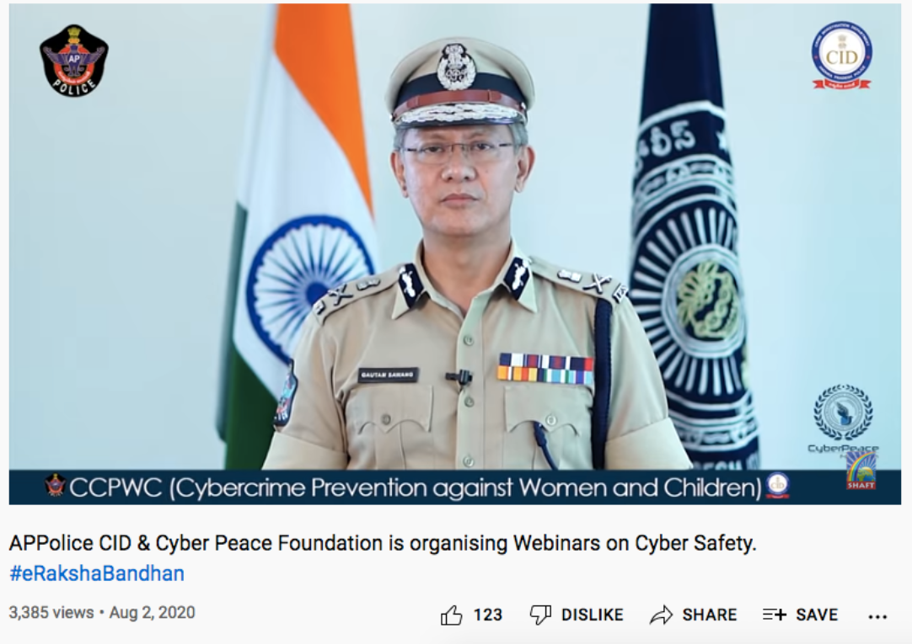

Slide 15
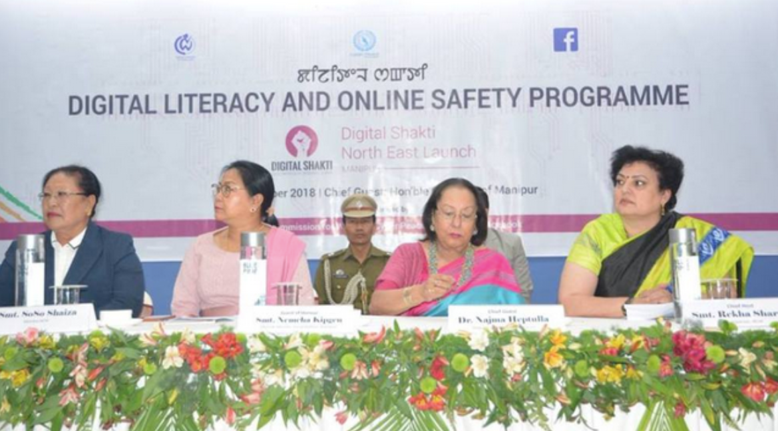

Slide 16
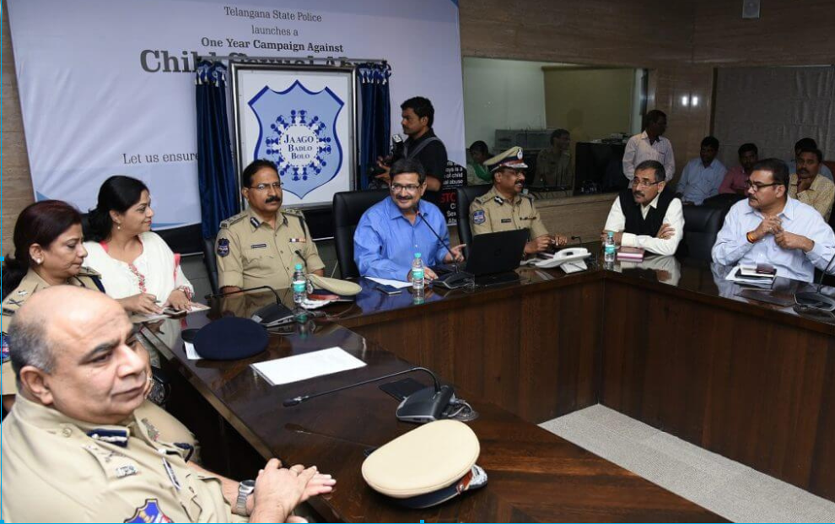

Slide 17
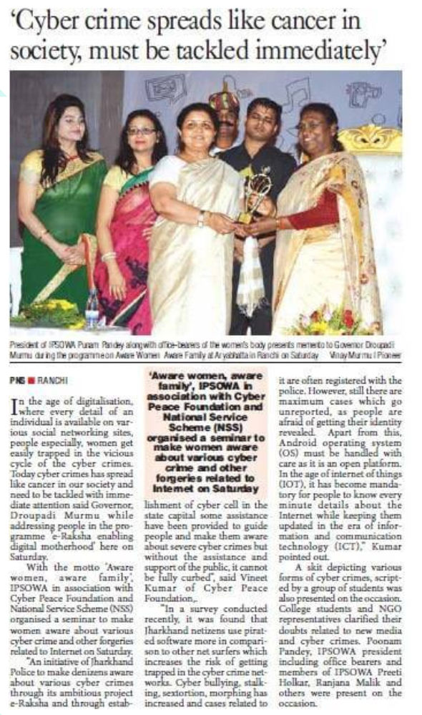
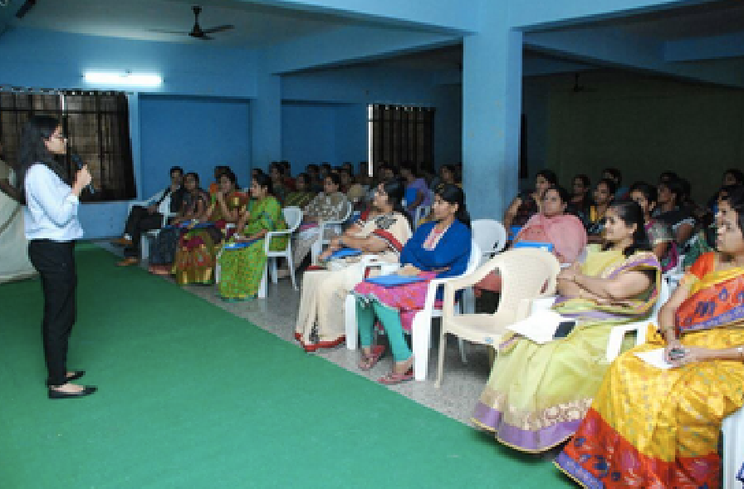
17
© Global Management Solution.

Slide 18
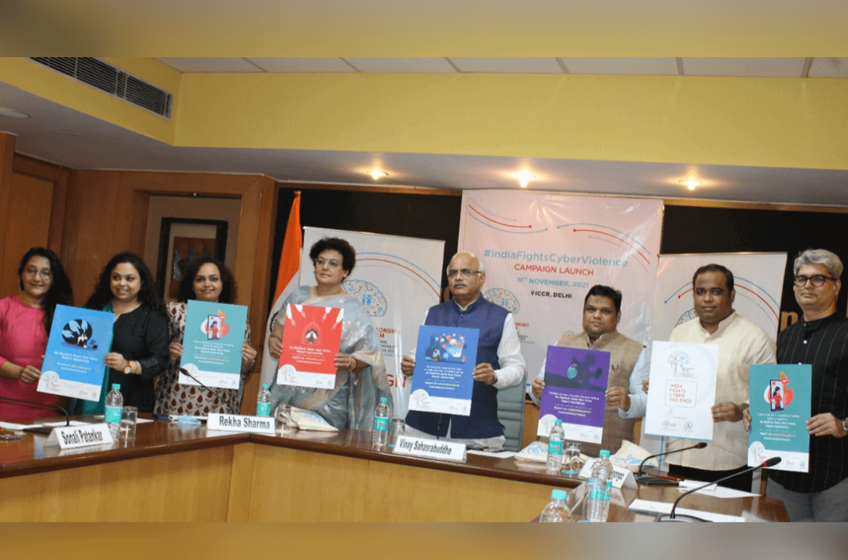
#IndiaFightsCyberViolence
was launched on
November 11, 2021
By
Vinay Sahasrabuddhe –
President ICCR, Member of
Parliament, Priyank Kanoongo –
Chairperson, NCPCR and
Rekha Sharma,
Chairperson NCW at the ICCR
Auditorium Delhi. The session
was also attended by the
CyberPeace Foundation team
members.

Slide 19
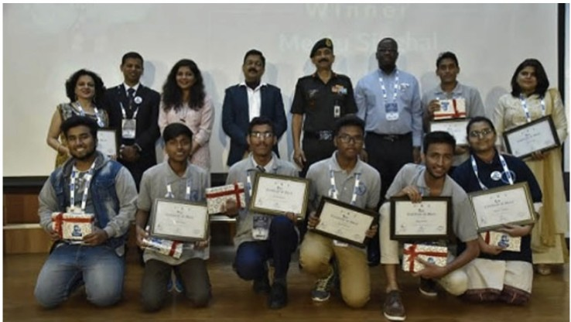
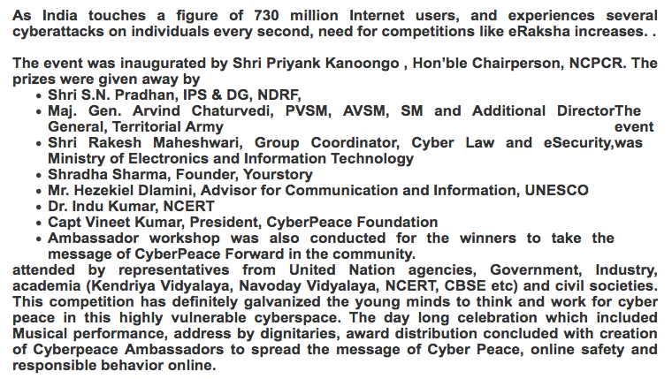

Slide 20
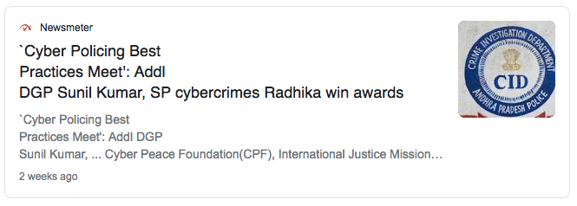
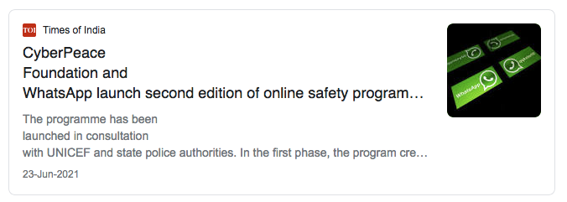
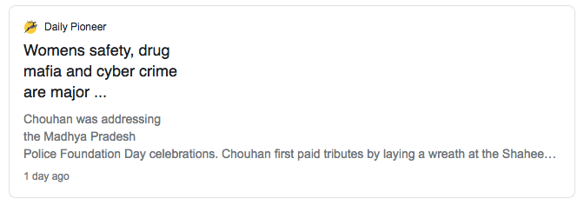

Slide 21
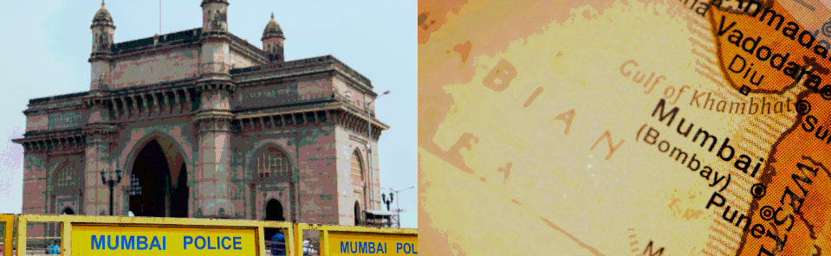
WI TH GREAT VI SI ON AND AWARENESS,
WE CAN SECURE OUR POLICE
PERSONALS AND OUR CITIZENS FROM BEI NG A VI CTI M OF CYBER CRI ME.
LET US HAVE A LOOK AT
PROJECTI ON PLAN !

Slide 22
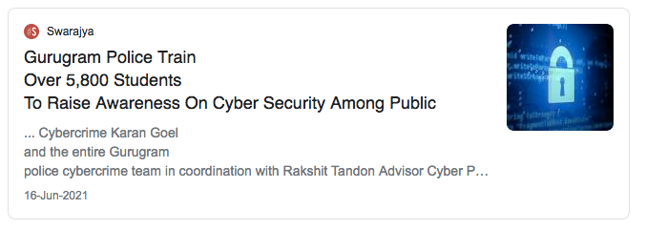
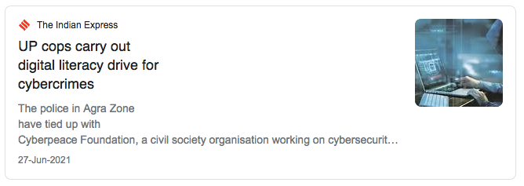
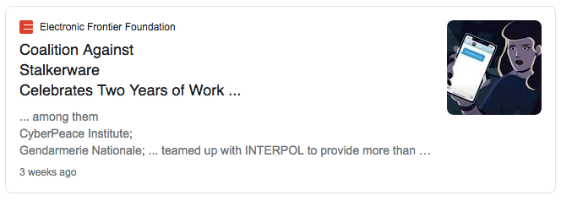

Slide 23

WI TH GREAT VISION AND AWARENESS, WE CAN SECURE OUR POLICE
PERSONALS AND OUR CITIZENS FROM BEING A VICTIM OF CYBER CRIME.
3 MONTH PROJECTION
6 MONTH PROJECTION
Seminars, Virtual Seminars, Sessions on cyber awareness, Cyber dialogue painting competition, quiz compition, hackathon, virtual conference with leaders in tech
Seminars, Virtual Seminars, Sessions on cyber awareness, Cyber dialogue painting competition, quiz compition, hackathon, virtual conference with leaders in tech, launch of Cyber Magazine.
1 Year PROJECTION
2 Year PROJECTION
Seminars, Virtual Seminars, Sessions on cyber awareness, Cyber dialogue painting competition, quiz compition, hackathon, virtual conference with leaders in tech, launch of Cyber Magazine + an app for Cyber Threat Updates + Launch of book that will include successfully Cyber Investigations
eminars, Virtual Seminars, Sessions on cyber awareness, Cyber dialogue painting competition, quiz compition, hackathon, virtual conference with leaders in tech, launch of Cyber Magazine + an app for Cyber Threat Updates
www.yourwebsite.com
Copyright © AeroTech. All rights.

Slide 24
Aerospace startups that will take you "to infinitiy and beyond"

Slide 25

3443 Finch Avenue East, Sute # 302, Toronto, Ontario, M1W2S1, Canada
Contact Us:
+14168349768
+8801878893598
manojbiswas@hotmail.com
manjob@glomansol.com
Skype: manoshag
www.golmansol.com

Slide 26
Thank You

