Slide 1
Proposal –
Bangladesh Police
Cyber Awareness Campaign
A complete porposal for creating cyber Awareness in maharashtra State during
the rise of Cyber Threats, Cyber Scams, Online Fraud and Call Spamers.

Slide 2
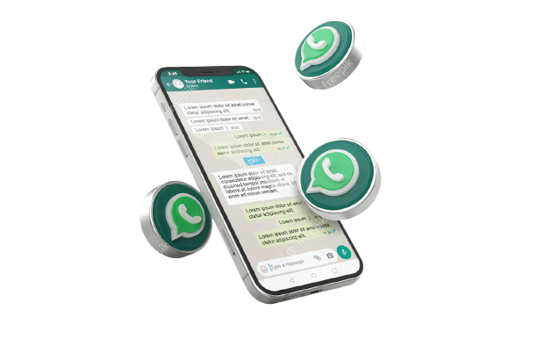
2
Whatsapp Intelligence
Description
Details of any particular Whatsapp Number.
Registered Date
Numbers Contacted
List of Called numbers
Chat Messages
Snap Chat Intelligence
© Global Management Solution.

Slide 3
3
Snap chat Intelligence
Description
• Details of particular Snap Chat ID
• Registered Date
• Total Snap Id's Connected
• Device Geographical Details
• Device currently registered
© Global Management Solution.

Slide 4
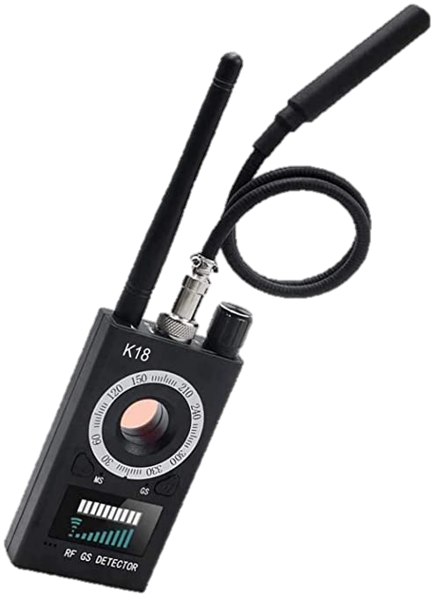
4
Electronic Bug
Detection
Description
• Electronic Bug Sweep and Detection
• Protect personal, private and business information
• Protect from Eavesdroppers
• Protecting intellectual property and business intelligen
• Identify the individuals who have been breached.
• Detect covert audio and video bugs
• GPS tracking devices and landline wiretaps.
• Counter Surveillance
© Global Management Solution.

Slide 5
5
Defamation
Description
• Protection from negative campaign on social media,
newspapers, Television Media and lobbying group in
the city or state.
• Protection from Honey-Trapping and recording the
videos/images as a proof.
© Global Management Solution.

Slide 6
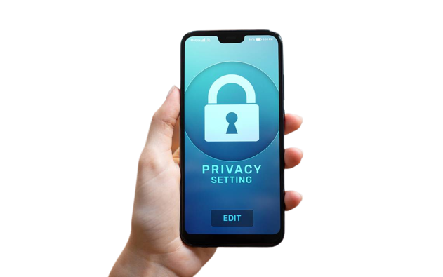
6
Defamation
Description
• 2048 Bit Encrypted mobile phone communications in the 3 layer Encryption using the ZRTP Protocol.
• IMSI Catcher Detection System.
• In-Built Apps, Signal and Wire.
• Always on VPNT or Bundle Layer.
• Global Iridium Network Capabilities
© Global Management Solution.

Slide 7
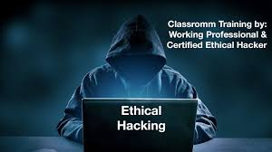
7
Ethical Hacking
Description
• Specialized in RAT
• Remote Spyware Installation services to help you provide the
data of their phone like - Gallery Images/Videos, Call logs,
Message Logs, Call Recordings, Internet Messenger's
Details except Signal App.
• Turning the Phone ON/OFF,
• Locate the Phone even if it's switched off.
• Remote Wipe the Device.
• Spoof Call and messages from the device to any other caller id.
• Both Web and App (Android/iOS/TailOS) mode available.
© Global Management Solution.

Slide 8
8
Emotion Analysis
Description
• Share variety of stimuli at people to measure
emotional response of target.
• Track and analyses responses
• Develop mechanism to gauge sophisticated
Psychological mapping and Emotional savvy brains.
© Global Management Solution.

Slide 9
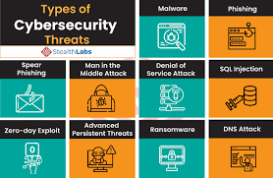
9
Cyber Security and Information Warfare Services in Politics
Description
Training, Setup of Systems with Secure walls, Secure Door and Kevlar Windows
included in it. We create and establish a facility for your information security and
analyst team responsible for monitoring and analysing security threats in real time.
SOC is the first line of defence for your organization. SOC teams are critical to
ensure timely detection and response of security incidents. The SOC
Includes more than this, as listed below:-
• Organizing security policies
• Analysing activities across an organization's network, endpoint servers and databases round the clock
• Real time Location Tracking Assistance of 1-499 people at the same time (we have to attack their devices/implant tracking
chips prior to the process of tracking and the charges are of Chip Implantation and Device Attack form remote location services
is excluded)
• Live OSINT Postal of every news channel (according to the country/state), social media (Facebook, Instagram, Twitter, Snap
Chat, Deep Web Threads)
• Live tracking/monitoring/observing and analysing of content over the Surface Web/Deep Web, New Portals and Web Forums.
© Global Management Solution.

Slide 10
3443 Finch Avenue East, Sute # 302, Toronto, Ontario, M1W2S1, Canada
Contact Us:
+14168349768
+8801878893598
manojbiswas@hotmail.com
manjob@glomansol.com
Skype: manoshag
www.golmansol.com

Slide 11
Thank You

